Slide 1
AN EXHIBITION IN THREE OBJECTS
Porcelain
in Translation
One porcelain tradition.
Three worlds.
01
The Chinese past
02
The Qing court
03
European markets
Presented by Xiwen Wang
Notes:
Slide 1: Poster introduction
Suggested segment: 0:00–0:45. English speaking only.
Today I am presenting Porcelain in Translation: one Chinese porcelain tradition, seen through three worlds—the Chinese past, the Qing court, and European markets. My question is how the same material acquired such different meanings.
I argue that Qing artisans and court institutions actively reshaped traditions, foreign knowledge, and overseas commissions. I will show this through a red-glazed vase, an enamelled bowl, and an armorial plate.
Content authority: project abstract.docx. Network connections are conceptual.

Slide 2
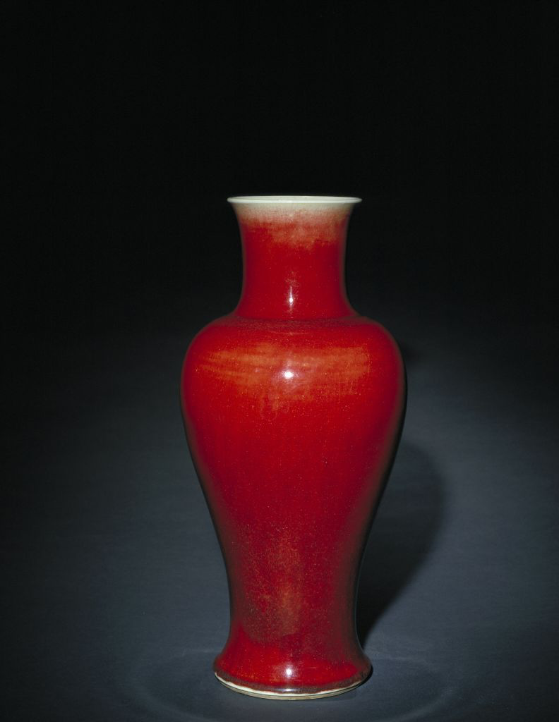
01 THE CHINESE PAST
Reviving
copper-red
Jingdezhen potters recovered
Ming copper-red glazing.
An inherited technique became
a statement of Qing identity.
Langyao-red Guanyin vase
Copper-red glaze | detail
Kangxi reign, 1662–1722 · Palace Museum
01
Notes:
Slide 2: Reviving copper-red
Suggested segment: 0:45–2:05. English speaking only.
This Langyao-red Guanyin vase belongs to the Kangxi period and is held by the Palace Museum. Its striking copper-red glaze recalls earlier Ming porcelain, especially Xuande-period wares. Jingdezhen potters revived a technique that was difficult to fire successfully.
For my exhibition, innovation begins by looking back. Qing potters used a renewed technical achievement to express imperial cultural identity. The past became a resource for making something meaningful in a new setting.
The vase therefore represents the Chinese past. It reminds us that a global history of porcelain begins with local traditions and the institutions that gave them value. These traditions formed the foundation for later exchanges.
This is the first process in my exhibition: reinventing tradition for Qing imperial culture.
Context source: https://intl.dpm.org.cn/Ceramicsis/944.html

Slide 3
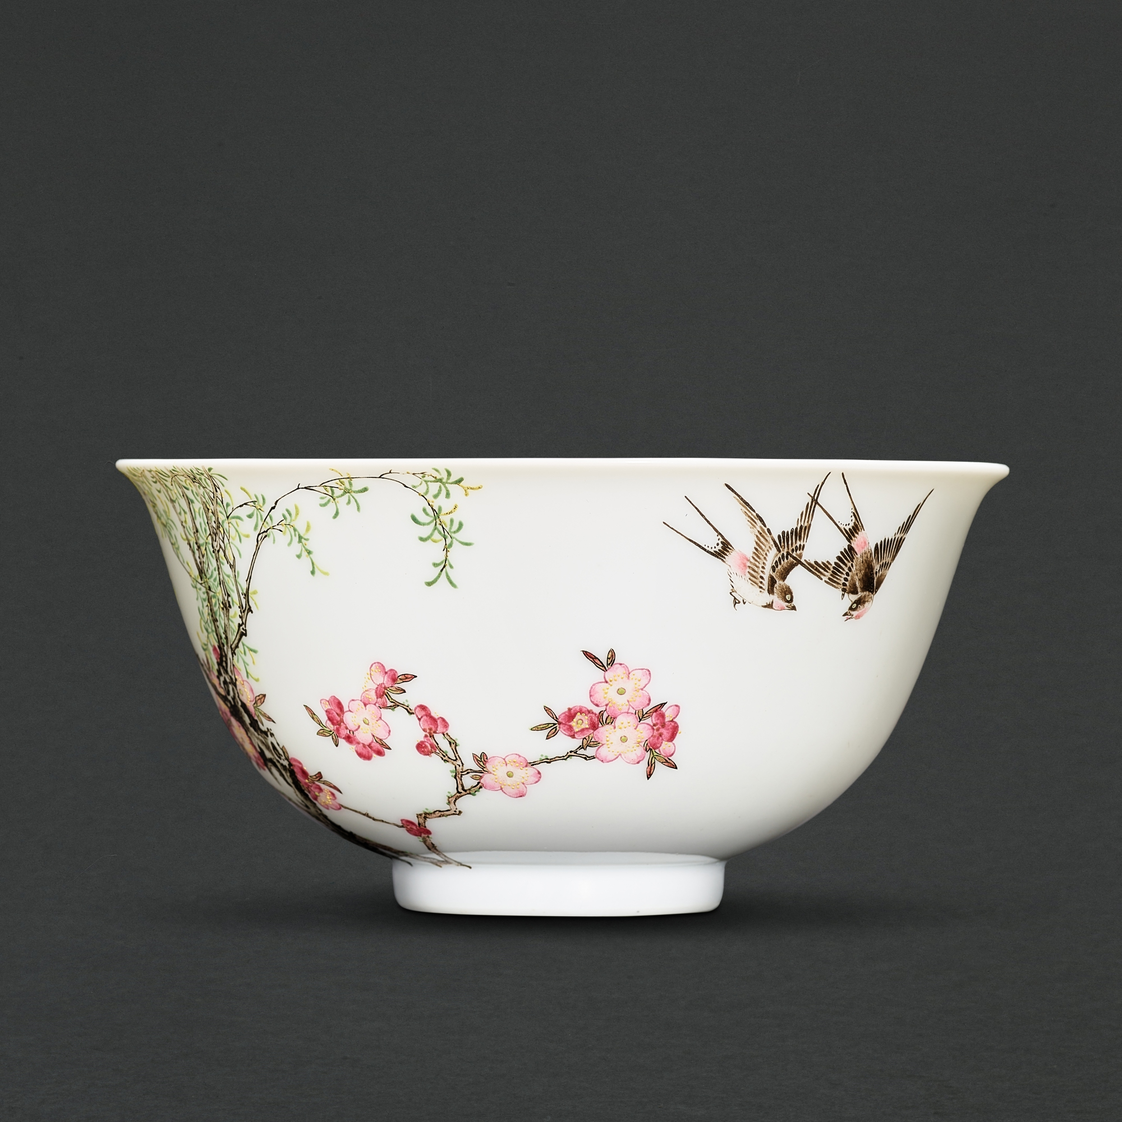
02 THE QING COURT
Enamels at the
Qing court
Swallows
in enamel
Qianlong reign, 1736–1795
European enamel knowledge
met Chinese porcelain and
bird-and-flower painting.
Beijing court workshops
selected and adapted these
techniques for imperial taste.
Imperial falangcai “swallows” bowl
JINGDEZHEN → BEIJING
02
Notes:
Slide 3: Enamels at the Qing court
Suggested segment: 2:05–3:35. English speaking only.
The second object is an imperial falangcai bowl from the Qianlong period. Swallows and flowering branches turn its surface into a Chinese bird-and-flower painting.
Its production connects several places and skills. Knowledge of European painted enamels and enamel pigments reached the Qing court. Porcelain bodies made at Jingdezhen were combined with this knowledge and Chinese painting in imperial workshops.
Court institutions selected and adapted foreign techniques to create objects suited to imperial taste. The bowl therefore represents the court as a site of cultural translation.
The European contribution mattered, alongside Chinese materials, painters, patrons, and workshop organisation. Technologies acquired new purposes and appearances as they entered this setting.
For my exhibition, the bowl shows that cultural exchange involved active choices. Foreign knowledge became part of a Chinese imperial aesthetic through the work of Chinese makers.
Context source: https://www.sothebys.com/en/digital-catalogues/a-timeless-ode-to-spring-the-dr-alice-cheng-falangcai-bowl

Slide 4
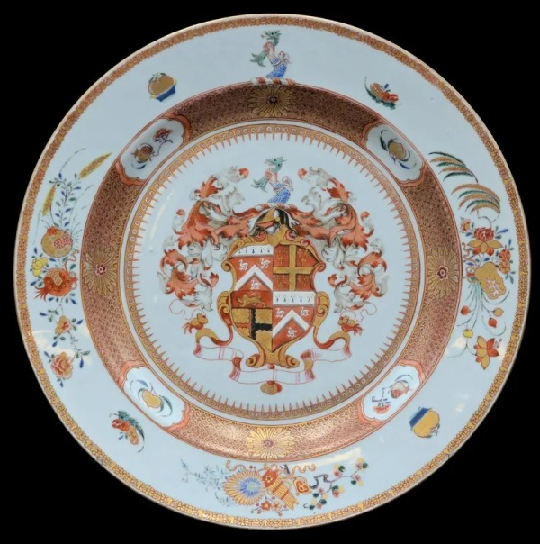
03 EUROPEAN MARKETS
EUROPE
A coat of arms,
made in China.
Designs
Wares
Chinese armorial export plate · eighteenth century
CHINA
European patrons sent
heraldic designs to China.
Chinese artisans made
porcelain for family identity
and social status.
Chinese production,
European family identity.
Heraldry | detail
03
Notes:
Slide 4: A coat of arms, made in China
Suggested segment: 3:35–5:05. English speaking only.
The third object is an eighteenth-century Chinese armorial export plate. Its central coat of arms connects the object to European patronage.
European customers sent heraldic designs and other requirements to China. Chinese artisans interpreted these images on porcelain, and finished wares returned to Europe through maritime trading networks.
The plate joined Chinese production to European ideas of family identity and social status. It was both a Chinese-made object and a personalised European commission.
This is the third process: responding to the market. Makers worked with visual conventions and expectations shaped by distant consumers.
The exchange moved in two directions: designs travelled east, while finished porcelain travelled west. Between those journeys, a drawing became a ceramic object through Chinese skills and decisions.
The plate shows how trade circulated images and reshaped the social meaning of porcelain.
Context source: https://www.metmuseum.org/exhibitions/listings/2003/chinese-export-porcelain

Slide 5
Porcelain changes meaning.
Tradition, court workshops and overseas patrons each shaped the object.
Beijing
Europe
Jingdezhen
Tradition
Court taste
Status
Qing makers actively shaped cultural exchange.
Guangzhou
Conceptual connections
04
Notes:
Slide 5: Porcelain changes meaning
Suggested segment: 5:05–6:35. English speaking only.
Together, the objects show three ways porcelain acquired meaning. The vase reworked Chinese tradition. The bowl translated European enamel knowledge within the Qing court. The plate turned European heraldry into an overseas commission.
Patrons, institutions, production, and use shaped these differences. One porcelain tradition could therefore address three worlds.
The network connects Jingdezhen, Beijing, Guangzhou, and European markets. It summarises flows of knowledge, designs, porcelain bodies, and finished wares. These are conceptual connections, not a documented shipping route for each object.
My main argument is that Qing China actively shaped global cultural exchange. Chinese makers revived inherited techniques, adapted foreign knowledge, and interpreted overseas demand.
Porcelain carried more than goods across borders. It helped technologies, images, aesthetic values, and social identities take new forms. That is the meaning of Porcelain in Translation. Thank you.
Content authority: project abstract.docx. Network connections are conceptual.

